Slide 1

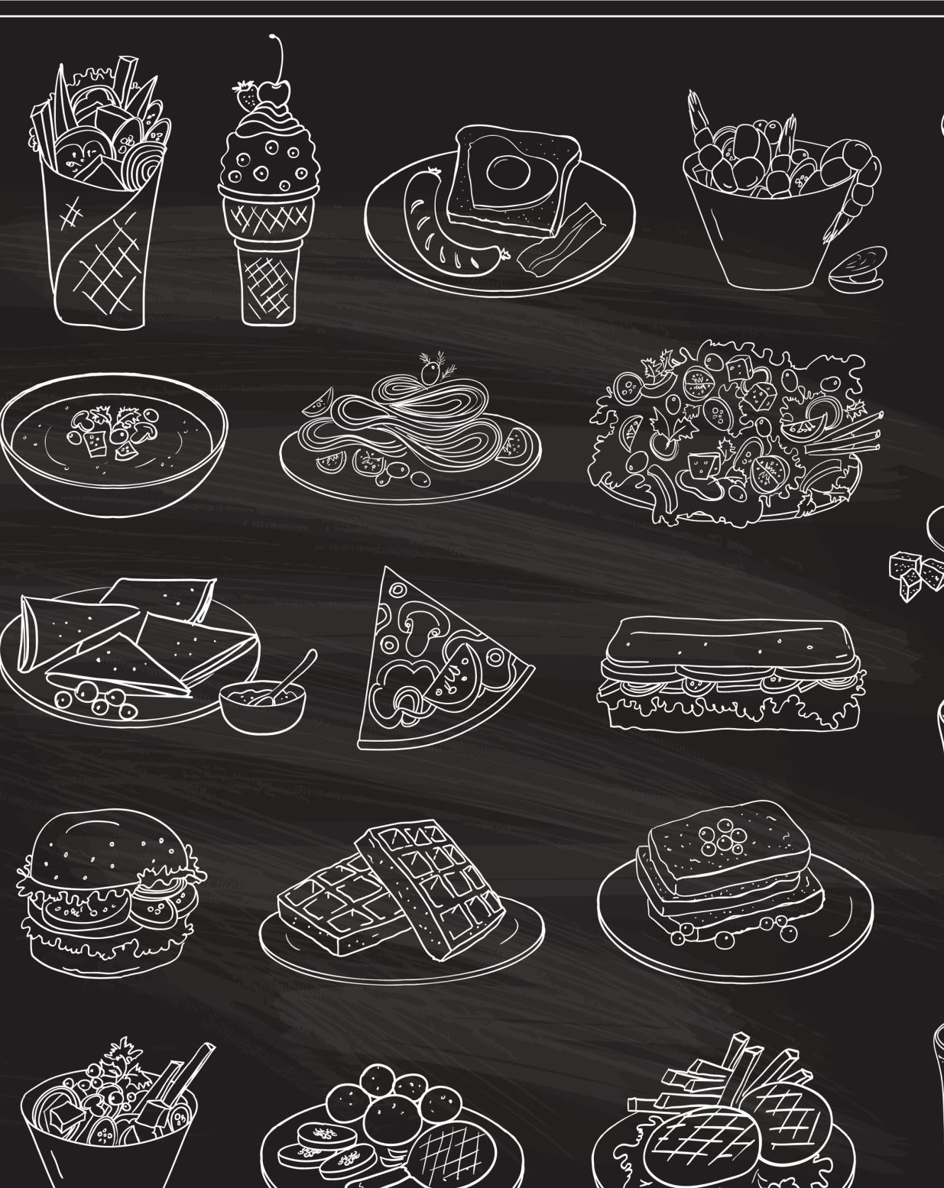
IDS 560 Capstone Final Presentation
Food Identification using
ML Models
#1
Shyam Patel

Slide 2
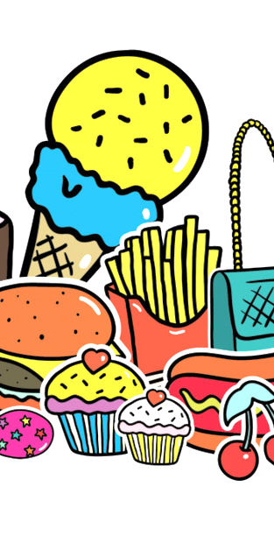
Statement of Work
Objective
Access to food and nutrition information quickly and reliably.
Result
A final product that benefits both consumers and food manufacturers/suppliers.
Approach
Provide up-to-date information on the ingredients used in each food item.
Purpose
Improving nutrition quality in the US food supply, Helping people make informed decisions

Slide 3
Statement of Work
Objective
Access to food and nutrition information quickly and reliably.
Purpose
Improving nutrition quality in the US food supply, Help people make informed decisions
Approach
Provide up-to-date information on the ingredients used in each food item.
Result
A final product that benefits both consumers & food manufacturers/suppliers.

Slide 4
Project stages

Slide 5
Project stages
WISEcode has a vast database of consumer packaged foods to categorize minimal features with high predictive power.
Notes:
The ultimate goal would be to have an ML algorithm that correctly identifies from a broad range of categories.
WISEcode LLC has a large database of consumer packaged foods in US retail outlets and is interested in categorizing and analyzing the data to identify the minimal set of features with high predictive power.
The research project will progress in stages, starting with a limited-use scenario to advanced algorithms, with the ultimate goal of correctly identifying food from a broad range of categories.
The first stage is to create an ML algorithm to discern whether given food data constitutes a "bread" or not.
The next stage involves expanding on the previous step to determine whether a given product is a muffin, donut, flatbread, etc.
The third stage seeks to quantify which categories are discernible, such as cake vs. pie, and whether cake vs. cupcake is discernible.
The final goal is to input food data and have an ML algorithm correctly identify the food from a broad range of categories.
The project is expected to provide valuable learning and insight for both the WISEcode project manager and the UIC capstone students, with completing all stages being a noteworthy achievement.

Slide 6
Project stages
WISEcode has a vast database of consumer packaged foods to categorize minimal features with high predictive power.
Stage 1: Create an ML algorithm to discern whether the given food is "bread" or not.
Notes:
The ultimate goal would be to have an ML algorithm that correctly identifies from a broad range of categories.
WISEcode LLC has a large database of consumer packaged foods in US retail outlets and is interested in categorizing and analyzing the data to identify the minimal set of features with high predictive power.
The research project will progress in stages, starting with a limited-use scenario to advanced algorithms, with the ultimate goal of correctly identifying food from a broad range of categories.
The first stage is to create an ML algorithm to discern whether given food data constitutes a "bread" or not.
The next stage involves expanding on the previous step to determine whether a given product is a muffin, donut, flatbread, etc.
The third stage seeks to quantify which categories are discernible, such as cake vs. pie, and whether cake vs. cupcake is discernible.
The final goal is to input food data and have an ML algorithm correctly identify the food from a broad range of categories.
The project is expected to provide valuable learning and insight for both the WISEcode project manager and the UIC capstone students, with completing all stages being a noteworthy achievement.

Slide 7
Project stages
WISEcode has a vast database of consumer packaged foods to categorize minimal features with high predictive power.
Stage 1: Create an ML algorithm to discern whether the given food is "bread" or not.
Stage 2:Whether a given food is a muffin, donut, flatbread, etc.
Notes:
The ultimate goal would be to have an ML algorithm that correctly identifies from a broad range of categories.
WISEcode LLC has a large database of consumer packaged foods in US retail outlets and is interested in categorizing and analyzing the data to identify the minimal set of features with high predictive power.
The research project will progress in stages, starting with a limited-use scenario to advanced algorithms, with the ultimate goal of correctly identifying food from a broad range of categories.
The first stage is to create an ML algorithm to discern whether given food data constitutes a "bread" or not.
The next stage involves expanding on the previous step to determine whether a given product is a muffin, donut, flatbread, etc.
The third stage seeks to quantify which categories are discernible, such as cake vs. pie, and whether cake vs. cupcake is discernible.
The final goal is to input food data and have an ML algorithm correctly identify the food from a broad range of categories.
The project is expected to provide valuable learning and insight for both the WISEcode project manager and the UIC capstone students, with completing all stages being a noteworthy achievement.

Slide 8
Project stages
WISEcode has a vast database of consumer packaged foods to categorize minimal features with high predictive power.
Stage 1: Create an ML algorithm to discern whether the given food is "bread" or not.
Stage 2:Whether a given food is a muffin, donut, flatbread, etc.
Final goal: To input food data to the ML model that correctly identifies it from a broad range of categories.
Notes:
The ultimate goal would be to have an ML algorithm that correctly identifies from a broad range of categories.
WISEcode LLC has a large database of consumer packaged foods in US retail outlets and is interested in categorizing and analyzing the data to identify the minimal set of features with high predictive power.
The research project will progress in stages, starting with a limited-use scenario to advanced algorithms, with the ultimate goal of correctly identifying food from a broad range of categories.
The first stage is to create an ML algorithm to discern whether given food data constitutes a "bread" or not.
The next stage involves expanding on the previous step to determine whether a given product is a muffin, donut, flatbread, etc.
The third stage seeks to quantify which categories are discernible, such as cake vs. pie, and whether cake vs. cupcake is discernible.
The final goal is to input food data and have an ML algorithm correctly identify the food from a broad range of categories.
The project is expected to provide valuable learning and insight for both the WISEcode project manager and the UIC capstone students, with completing all stages being a noteworthy achievement.

Slide 9
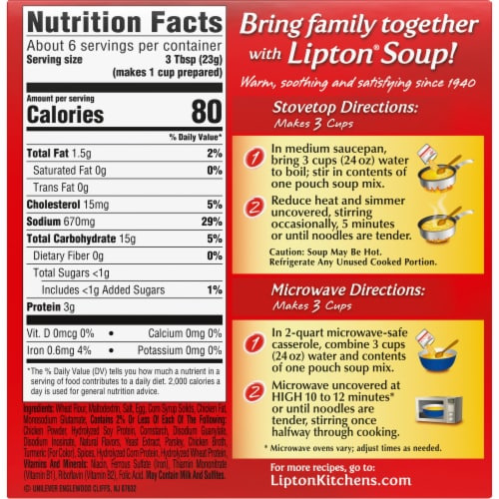
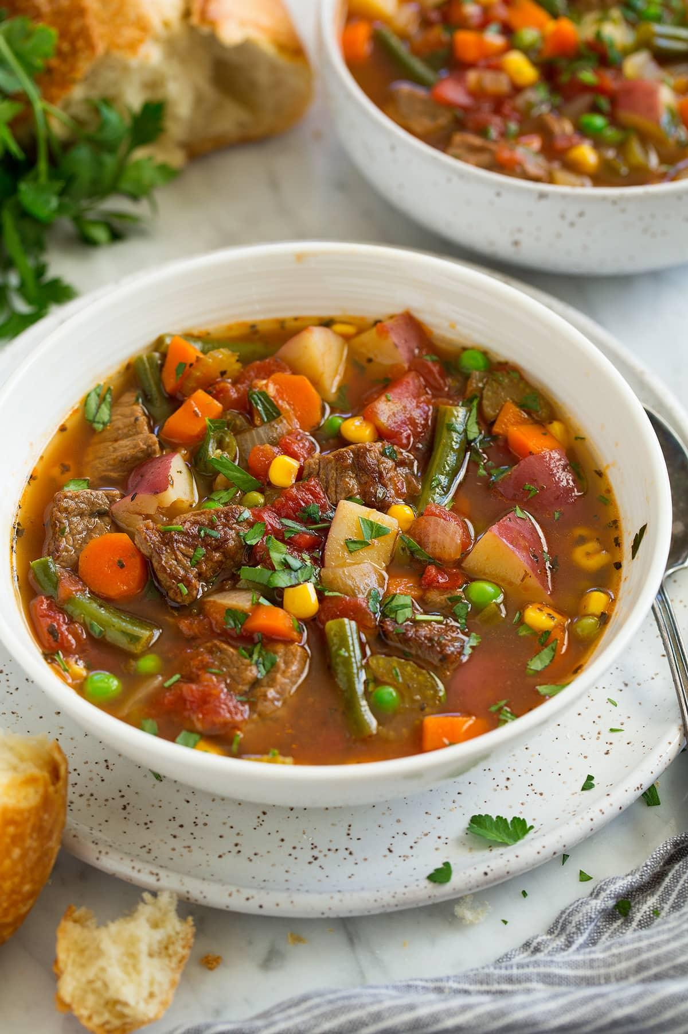

A perfect example would be:
What kind of food is this?
Notes:
Let's say somebody is a vegetarian and come across a soup that they want to try. They check the ingredient list but it only says "natural flavorings" without specifying the source. We are not sure if it contains beef stock, which would make it unsuitable for our diet.
By inputting the ingredient list into the ML algorithm, it can accurately identify if the soup contains any animal-based ingredients such as beef stock, chicken broth, or fish sauce.
With this information, anyone can make an informed decision about whether or not to purchase and consume the soup. This can be especially helpful for people with dietary restrictions or ethical considerations regarding their food choices.

Slide 10
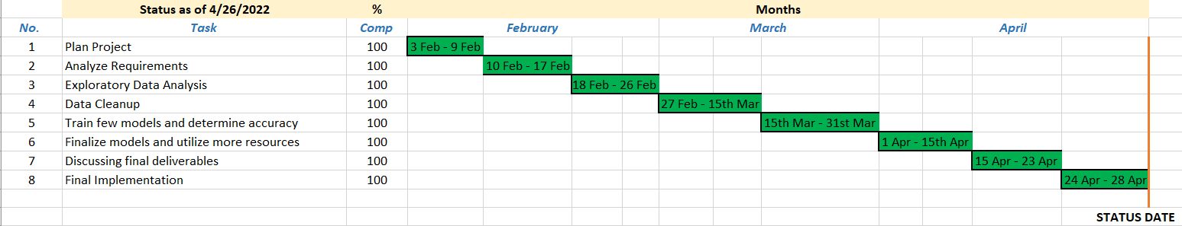
Gantt Chart

Slide 11
Expected Deliverables
Development of ML models to accurately identify food items based on ingredient lists.
Minimal set of features with high predictive power
Documentation and code for the ML algorithms.
Potential improvements or expanding to include more food categories or developing more advanced algorithms.
Notes:
The primary deliverable of the project would be the development of various ML algorithms to accurately identify different types of food items based on their ingredient lists.
A report outlining the minimal set of features with high predictive power and the overall performance of the ML algorithms. This information would be valuable for developing more efficient and accurate ML algorithms in the future.

Slide 12

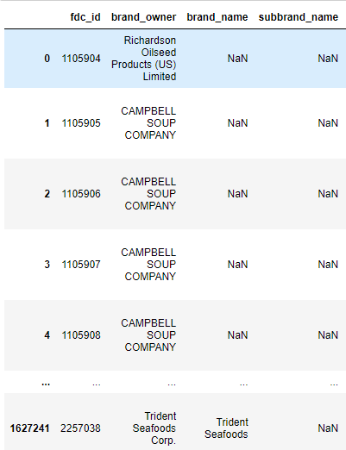
Dataset Description
fdc_ id to distinguish unique food record
Brand details
Brand name may contain information
Notes:
The dataset consists of three primary features: Brand details, Ingredients, and serving size and unit details.
Among the three columns, the ingredients column was identified to have high predicting power after running sentiment analysis on all main features.
Based on this finding, we have selected the ingredients column as the minimum feature with high predictive power that the company requires for further analysis.

Slide 13
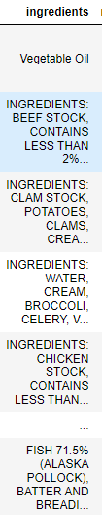
Dataset Description
Ingredients
Ingredients for each food category
This feature contain the most information used for our analysis
The order of ingredients - Descending order of amounts used
Notes:
The dataset consists of three primary features: Brand details, Ingredients, and serving size and unit details.
Among the three columns, the ingredients column was identified to have high predicting power after running sentiment analysis on all main features.
Based on this finding, we have selected the ingredients column as the minimum feature with high predictive power that the company requires for further analysis.

Slide 14
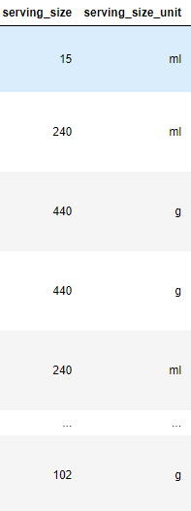
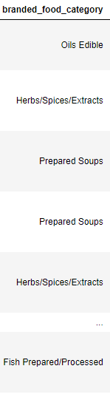
Dataset Description
v
Serving size & unit detail Target variable
Notes:
The dataset consists of three primary features: Brand details, Ingredients, and serving size and unit details.
Among the three columns, the ingredients column was identified to have high predicting power after running sentiment analysis on all main features.
Based on this finding, we have selected the ingredients column as the minimum feature with high predictive power that the company requires for further analysis.

Slide 15
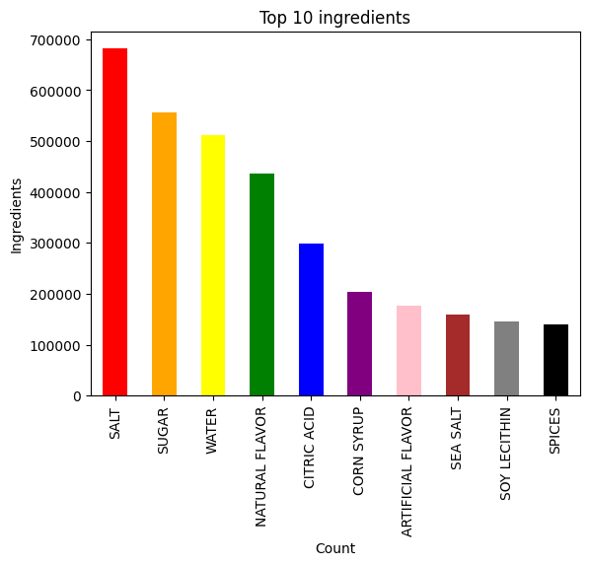
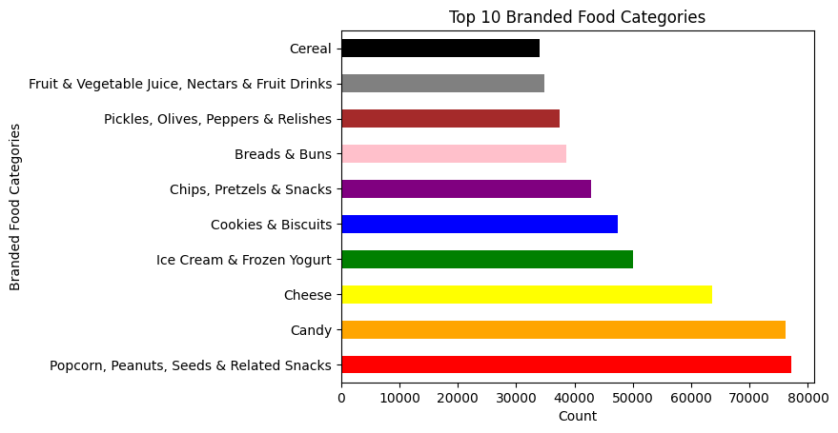
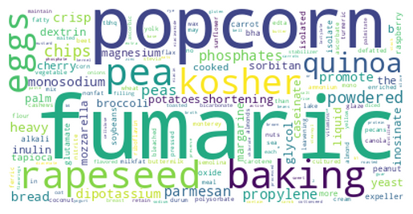
Visualization
Top 10 Branded food categories
Top 10 ingredients
Top 200 words (important) higher weight in the embedding layer.

Slide 16
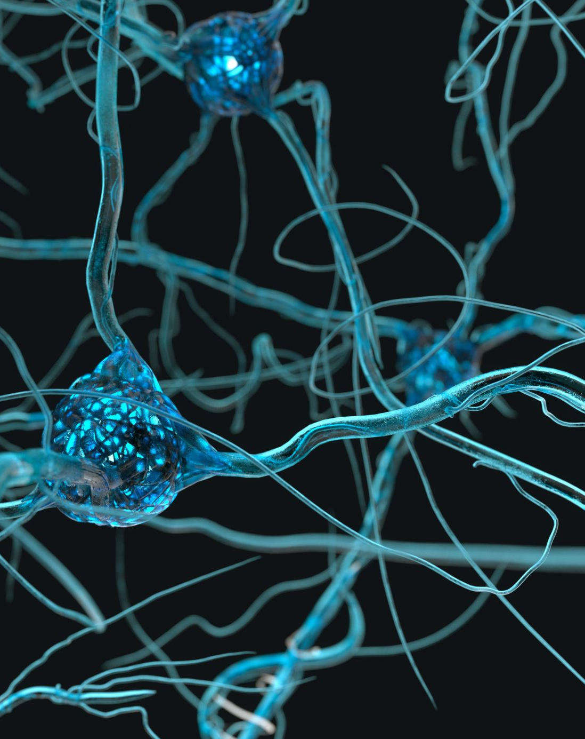
Recurrent Neural Network Long Short-Term Memory
Let’s talk about reasons why RNN was a good choice for this task

Slide 17

Why RNN with LSTM?
RNNs are a natural fit for sequential data (Text)
Our goal was to predict food categories based on ingredients which are text (multi-classification problem)
RNN with the LSTM model can learn long-term dependencies in sequential data.
Notes:
Our final model was chosen to be RNN
RNNs are a natural fit for sequential data like text
Our goal was to predict food categories based on ingredients which is a text multi-classification problem
RNN with the LSTM model is able to learn long-term dependencies in sequential data, which makes it particularly effective for processing text data.

Slide 18
RNN Architecture
Batch Normalization:
Normalizes output from previous to improve the stability
Dense output layer:
Uses SoftMax activation to give probability distribution for better optimization
Embedding layer:
To convert input text into a fixed vectors and to learn semantic relations in words
LSTM Layer:
The main layer processes the input sequences.
Notes:
the model uses an Embedding layer to convert the input text into a fixed-length vector
The Embedding layer allows the model to learn semantic relationships between words in the input text, which is important for accurate classification.
The dense output layer with SoftMax activation outputs a probability distribution over the classes for a multi-class classification problem.
Finally, the RNN with LSTM model was trained using early stopping to prevent overfitting, which is important in any machine learning task.

Slide 19
RNN Architecture
Batch Normalization:
Normalizes output from previous to improve the stability
Dense output layer:
Uses SoftMax activation to give probability distribution for better optimization
Embedding layer:
To convert input text into a fixed vectors and to learn semantic relations in words
LSTM Layer:
The main layer processes the input sequences.
Notes:
the model uses an Embedding layer to convert the input text into a fixed-length vector
The Embedding layer allows the model to learn semantic relationships between words in the input text, which is important for accurate classification.
The dense output layer with SoftMax activation outputs a probability distribution over the classes for a multi-class classification problem.
Finally, the RNN with LSTM model was trained using early stopping to prevent overfitting, which is important in any machine learning task.

Slide 20
RNN Architecture
Dense output layer:
Uses SoftMax activation to give probability distribution for better optimization
Batch Normalization:
Normalizes output from previous to improve the stability
LSTM Layer:
The main layer processes the input sequences.
Embedding layer:
To convert input text into a fixed vectors and to learn semantic relations in words
Notes:
the model uses an Embedding layer to convert the input text into a fixed-length vector
The Embedding layer allows the model to learn semantic relationships between words in the input text, which is important for accurate classification.
The dense output layer with SoftMax activation outputs a probability distribution over the classes for a multi-class classification problem.
Finally, the RNN with LSTM model was trained using early stopping to prevent overfitting, which is important in any machine learning task.

Slide 21
RNN Architecture
Dense output layer:
Uses SoftMax activation to give probability distribution for better optimization
LSTM Layer:
The main layer processes the input sequences.
Batch Normalization:
Normalizes output from previous to improve the stability
Embedding layer:
To convert input text into a fixed vectors and to learn semantic relations in words
Notes:
the model uses an Embedding layer to convert the input text into a fixed-length vector
The Embedding layer allows the model to learn semantic relationships between words in the input text, which is important for accurate classification.
The dense output layer with SoftMax activation outputs a probability distribution over the classes for a multi-class classification problem.
Finally, the RNN with LSTM model was trained using early stopping to prevent overfitting, which is important in any machine learning task.

Slide 22
RNN Architecture
Dense output layer:
Uses SoftMax activation to give probability distribution for better optimization
LSTM Layer:
The main layer processes the input sequences.
Batch Normalization:
Normalizes output from previous to improve the stability
Embedding layer:
To convert input text into a fixed vectors and to learn semantic relations in words
Notes:
the model uses an Embedding layer to convert the input text into a fixed-length vector
The Embedding layer allows the model to learn semantic relationships between words in the input text, which is important for accurate classification.
The dense output layer with SoftMax activation outputs a probability distribution over the classes for a multi-class classification problem.
Finally, the RNN with LSTM model was trained using early stopping to prevent overfitting, which is important in any machine learning task.

Slide 23
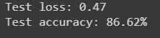
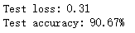
Results
Categories | Precision | Recall | F1-score | Support
Yogurt | 0.97 | 0.98 | 0.97 | 3096
Breads & Buns | 0.95 | 0.95 | 0.95 | 3793
Candy | 0.93 | 0.87 | 0.90 | 7540
Candy | 0.97 | 0.98 | 0.98 | 6394
Test Accuracy for 80 food categories
Classification Report
Runtime: 3 min/epoch
Notes:
91%

Slide 24
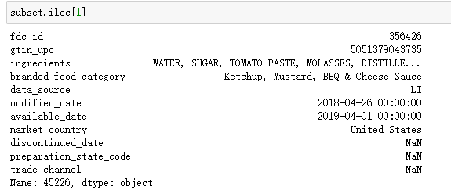
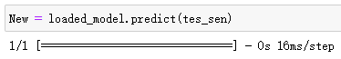
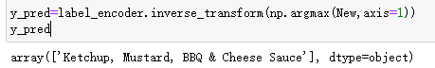
How our model works
Example
Step 2: Use model to predict
Final output after inverse label encoder
Step 1: Preprrocessing
Notes:
This is how our model works, we first take the ingredients sentence as an input text. Then we modify the text by tokenizing and converting it into vectorized form which is then padding to get a uniform length and finally feed in to the trained model
Further the model predicts and gives the output which is a number given by the label encoder for each of the classes. We then perform an inverse transformation to get the label of the class/category predicted by our model which is the final output

Slide 25
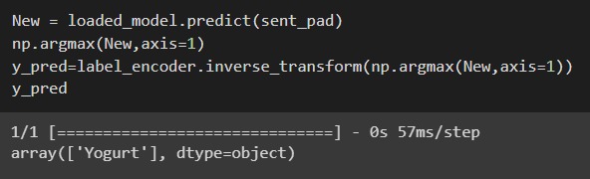
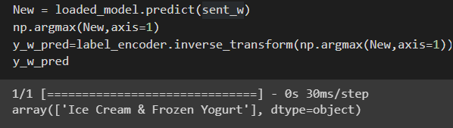
Instance of Misclassification
Food category ‘Yogurt’ with high F1 Score of 97%
Yogurt
Final output after inverse label encoder
Ice Cream & Frozen Yogurt
Final output after inverse label encoder
Notes:
Here is where our model correctly classify a given sentence into the 'Yogurt' category in first example
However, in a second example, it misclassifies the sentence as belonging to the 'Ice cream & frozen yogurt' category.
This misclassification can be understood as these two categories are closely related and may have overlapping features.
Our model is still able to accurately classify the majority of sentences, and its performance can be improved by incorporating additional features.

Slide 26
How our model works
(Example of incorrect classification)
Food category ‘Yogurt’ with high F1 Score of 97%
Modify it to sequence to feed into trained model
Final output after inverse label encoder

Slide 27
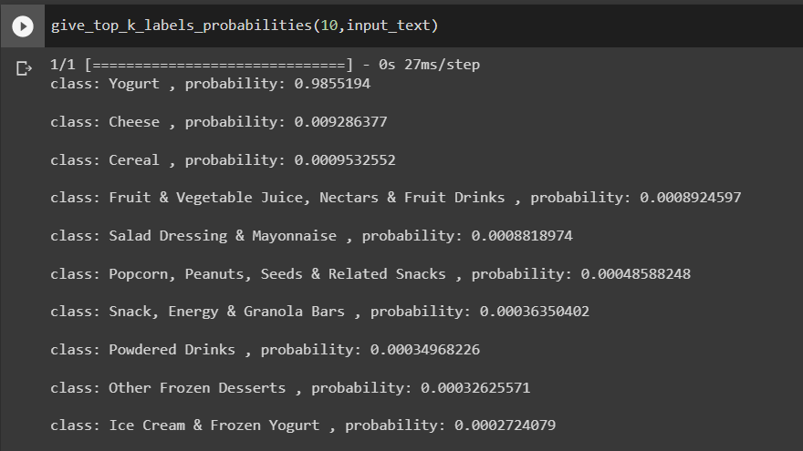
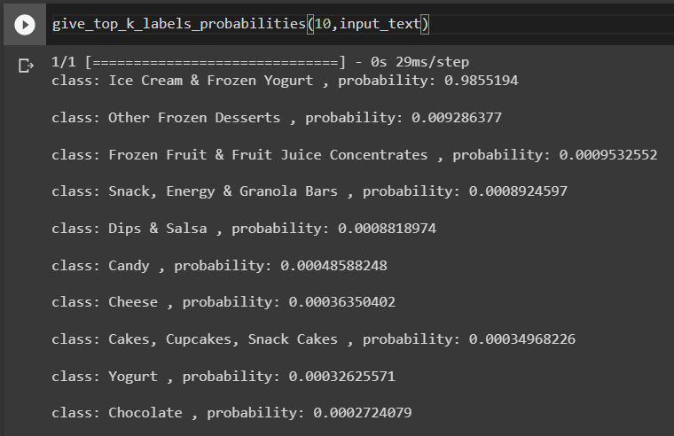
Softmax probability of top 10 predictions
Correct classification top 10 probabilities
Incorrect classification top 10 probabilities
Notes:
We computed softmax probabilities for all the classes and here is the probability for top 10 predictions for class yogurt
As we can see,in the first example, where the model correctly classifies yogurt has probability of 0.98 and other 9 predictions have very less probabilities
And for the misclassified example, Ice cream & Frozen Yogurt has 0.98 probability and the correct class ‘yogurt’ stands 9th predicted class..

Slide 28
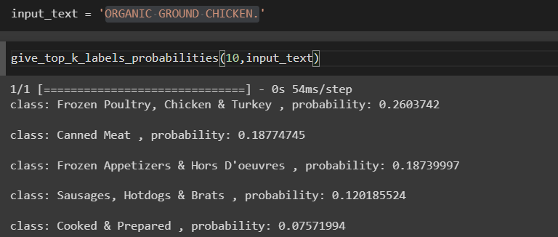
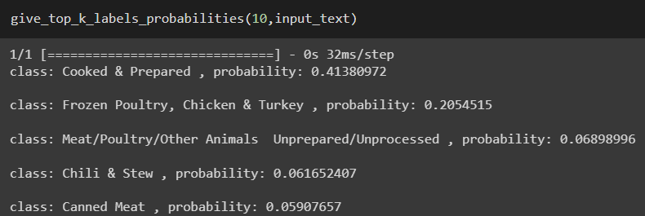
Cases with ambiguous classification results
input_text = 'TURKEY ROAST: DARK TURKEY, WHITE TURKEY, CONTAINING UP TO 26% OF A SOLUTION OF TURKEY BROTH, MODIFIED FOOD STARCH, SALT, SUGAR, SODIUM PHOSPHATE, NATURAL FLAVORING. GRAVY: WATER, SEASONING (MODIFIED FOOD STARCH, SWEET WHEY SOLIDS (MILK), CORN STARCH, AUTOLYZED YEAST EXTRACT, SALT, CARAMEL COLOR, CALCIUM CASEINATE (MILK), ONION POWDER, PAPRIKA, XANTHAN GUM, DICALCIUM PHOSPHATE, FLAVORING).'
Notes:
This is case of ambiguous classification where the ingredient “Organic Ground Chicken” which gives comparable probabilities to first three classes as it can be classified as either of them.
These examples indicate the inaccuracy in discerning certain classes like frozen poultry, chicken and turkey has a lot of overlapping features with other classes such as cooked & processed

Slide 29

Reasons for high accuracy
Sufficient amount of training, high-quality data
Effective preprocessing (Tokenization, Padding)
Suitable architecture as discussed in the previous slide
Use of early stopping callback- prevents overfitting
Effective optimizer- Adam
Effective Loss function - Sparse Categorical Cross-entropy
Notes:
Sufficient amount of training data, high-quality data provided by Wisecode
Effective preprocessing and feature engineering-(tokenization, padding)
Suitable architecture as discussed in the previous slide
Early stopping callback: prevents overfitting
Effective choice of optimizer( Adam), loss function(sparse categorical cross-entropy and metric (accuracy)

Slide 30
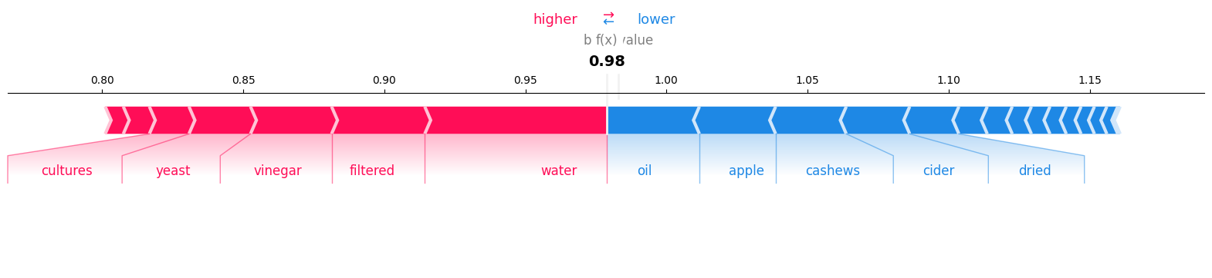
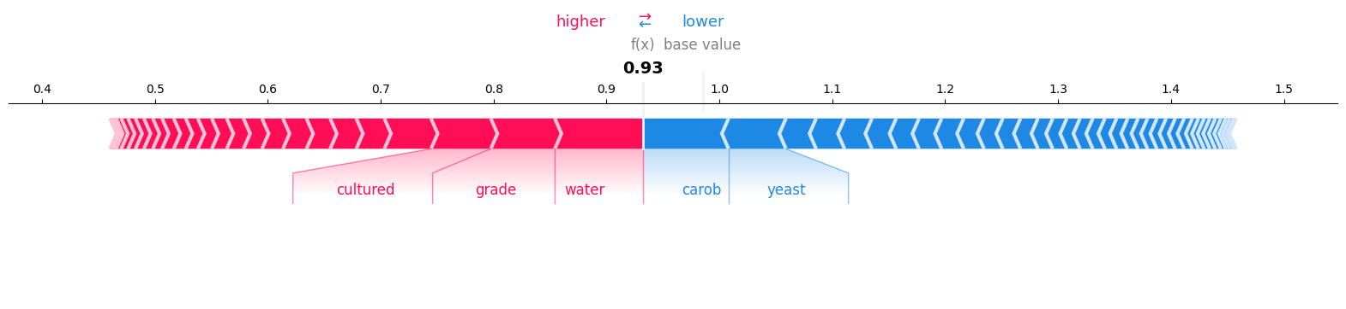
Yogurt
Cheese
Testing the model with SHAPley values
Notes:
Shapley values help to answer the question: "How much did each input feature contribute to the final prediction made by the model?”
This information could be used to refine the model, improve its accuracy, and to understand how it is making predictions.
In this example, The expected value of the prediction is 0.98
Features in red indicate they have higher value than the base predicted value while features in blue has lower level value than the predicted value.
equal number of positive and negative features in making its prediction.
Similarly, for yogurt, expected prediction is 0.93 and carob, yeast reduces predicted value.

Slide 31

Challenges Faced & Key Learnings
A big challenge: The dataset was enormous and had a significant impact on runtime.
Created subsets.
Inconsistency in parsed dataset (ingredients.csv)
Tokenized ingredients using keras text preprocessor
Hardware constraints

Slide 32

Conclusion
Our model effectively learned the relationship between ingredients & food categories, achieving high accuracy.
Our model can be a valuable tool for food companies to automate their product categorization
Overall, our project demonstrates the effectiveness of deep learning models for NLP tasks such as ingredient-based food categorization.

Slide 33

Thank You! Questions?

